Slide 1


Partnered with
SAP S/4HANA & MINING
CAPABILITY

Slide 2

Corporate
Overview

Slide 3

Who we are
A leading digital solutions and technology services
company
Lineage
$100+Mn Organization
Investors from US- Lorhan Corp and IT America
Global
1500+ employees globally
300+ Overall clients
120+ Active Clients
45+ Active Managed Services Engagements
Customer in 25 Countries across 5 Continents
11 Offices in India, US, Australia and UAE
￼

Slide 4
S/4 HANA Capabilities
With SAP S/4HANA®, businesses can create the digital core and benefit from a next-generation ERP built on most advanced in-memory platform-designed with most modern User experience-S/4 HANA can be deployed on premise, cloud or hybrid. SAP S/4HANA simplifies and accelerates key business scenarios with in-memory technology
SAP S/4HANA is designed with SAP Fiori user experience. With SAP Fiori UX, business users can now get a personalized, responsive and simple experience to get the job done from anywhere. This role-based experience built with modern design principles provides instant insight on any device for a completely remained user experience.
Departmental applications can be consolidated and united by a new digital core and connected to external partners, suppliers, and machines.
Cloud applications that support and extend the digital core are tightly integrated into the core with SAP HANA Cloud Platform. Examples include SAP Ariba®, SAP Success Factors®, and SAP Fieldglass® solutions, Concur® technology, and SAP Integrated Business Planning and SAP Business Objects, IoT technology
S/4HANA offers Instant, real-time insight for better decisions, Reinvented processes for higher performance. Higher productivity, Simplified Architecture for lower TCO

Slide 5
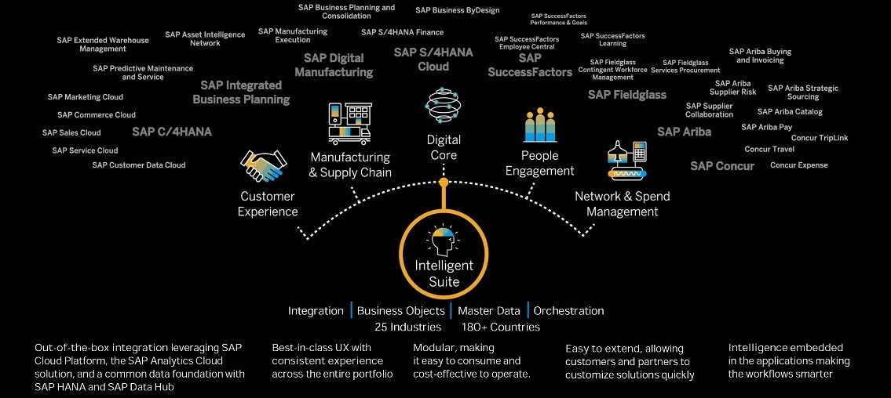
Intelligent Suite
Brownfield & Greenfield

Slide 6

We have strong capabilities in SAP
Experience
800+ SAP resources globally
200+ SAP Implementations
8 Suite On HANA (SoH) Migrations
25+ S/4HANA Greenfield Projects
30+ SAP Global Rollouts
50+ Upgrades
35+ Managed Services
40+ Shared Support Services
Global Presence
Implementations 25 countries across:
Indian Subcontinent
North America
Europe
Asia-Pacific
Middle East
Africa
Industry Focus
Life Sciences
Chemicals
Industrial Machinery and Components (IM&C)
Consumer Products and Goods
Food and Beverage
Textile
Mines &Metals
SAP Awards and Recognition
Best Customer Implementation Award
SAP Most Innovative Partner
Emerging Business - Fastest Growing Partner
SAP Best Run Award in implementation
Award for adopting Digital Initiatives in Public and Social Sector
Future Ready
SAP S/4HANA solution for mining industry
SAP S/4HANA Preconfigured Solution for Life Sciences Industry
SAP S/4HANA Preconfigured Solution for Chemical Industry
SAP S/4HANA Preconfigured Solution for IM&C Industry
SAP S/4HANA Preconfigured Solution for Dairy Industry
SAP S/4HANA Preconfigured Solution for Textile Industry
Accelerators to deliver cost effectiviness
5 industry specific S/4HANA Preconfigured Solutions
S/4HANA Brownfield Conversions Accelerators – Pre-Conversion, Conversion and Post Conversion Tools
S/4HANA Greenfield Implementation Jumpstart Toolkits and Enablers

Slide 7
SAP S4HANA Capabilities and Experience
Key facts and figures
SAP HANA Centre of Excellence
8 Suite on HANA and 25 S4HANA implementation projects globally with our first HANA implementation over 3 years ago
450+ S/4HANA Professionals – Functional / ABAP / BASIS / Fiori / Analytics
100+ HANA Use Cases identified for business functions and industries
S4 HANA implementation / Conversion Toolkit and accelerators
SAP HANA Center of Excellence at Hyderabad, India
  Proof-of-concept and pilot projects
  Define and execute road maps
  SAP showcase HANA capabilities in industry “Day-in-the-Life” scenarios, Technology demos
Preconfigured Solutions on S4HANA:
  Fully configured industry-specific SAP S4HANA Solutions with best practices, templates, assets, Test scripts and Tools
  5 industry solutions on S4HANA
  20 tested end-to-end scenarios
VALUE DISCOVERY WORKSHOPS
Innovation Workshops
S4HANA Roadmaps
Industry Use Cases
Day in the Life Scenarios
Technology Demos
SAP HANA PILOT’s
Proof-of-Concepts
Pilots
SME Support
Performance Reviews
DELIVERY SUPPORT
Use Cases
Reuse of Assets
SME Support
Standardized Methodology
HANA Solution Factory at our Delivery Center in India
SAP HANA LAB
Global HANA CoE
SME Network
Performance Reviews
Competency Building
Technology Evaluation
7

Slide 8





SAP Analytics Capability Overview
We continuously invest to keep our team, relationships, assets, delivery and breadth of services at their peak. Our extensive capabilities range from accessing and reporting on data to advanced data modeling, forecasting and sophisticated statistical analysis
  50+
SAP Analytics Professionals
  12+
  Years of advanced
  analytics experience
  10+
Trained Resources on
SAP Analytics Cloud (SAC)
  50+
  SAP Analytics and EPM Projects
  15+ BW / BO Implementations
  10+ BW on HANA Implementations
  10+ BW/4HANA Implementations
  10+ BW on HANA Migrations
  5+ BPC Implementations
  25+
  Global Clients
  5
  Offices and operations
  from which Lorhan serves clients

Slide 9
SAP Service Portfolio
Solution Discovery and Design
Solution architecting
Business transformation consulting
Industry benchmarks and Best Practices
Business Process assessment
Global Delivery Model and
SAP Lifecycle Management tools
Plan
Implementations and Rollouts
Business Process re-engineering
SAP S/4HANA Global implementations & roll outs
SAP Fiori / UX deployment and Implementations
SAP BI / BO Analytics and EPM – BPC Implementations
Build
Upgrade, Enhance and Improve
SAP SoH Migrations and S/4HANA Brownfield Conversions
SAP S/4HANA Greenfield Deployments
SAP BW on HANA and BW/4HANA migrations / Implementations
Manage
Build and Manage
Applications Management Services
SAP Shared Services
Risk Reward Model
Catalogue Based Model
Improve
Application Portfolio Rationalization
Application roadmap
Application portfolio rationalization
SAP ERP led continuous business process improvements
Cloud Migrations

Slide 10
SAP for Mining Industry
Challenges in Mining
Fluctuating Demand
Price Volatility
Mergers & Acquisitions
Long Gestation period, Medium RoI
CSR
Quality Management & Stocking
Safety
Value Chain in Mining
Suppliers & Contractors & Work force
Mining & Mine Management & Machinery
Processing
Transportation
Marketing
CRM
SAP Solutions on HANA platform to meet above
GRC
Supply Chain management
Operations Management
Remote site Logistics
Enterprise Asset management
EHS
Budgeting & Forecasting
Quality Management
HCM, PI

Slide 11
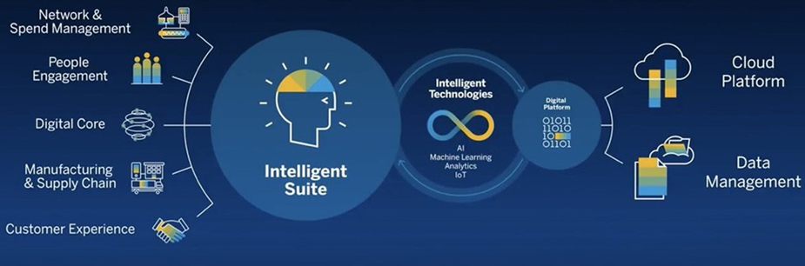
Delivering the Intelligent
Enterprise
Intelligently Connecting People, Things & Businesses

Slide 12
SAP Solutions for Mining

Slide 13
SAP Value Proposition for Mining

Slide 14

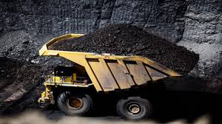
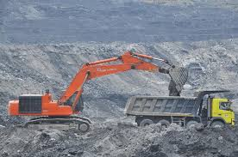
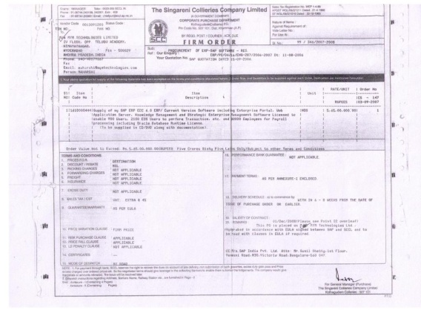
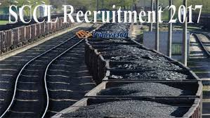


MYM relationship with
Singareni Collieries company Ltd.
Singareni Collieries is one of largest India based mining company with 50000 employees and with 18 open cast and 30 underground mines. It reserves a stretch of 350 Km for Mining exploration with geological reserves of 8800 Million Tones and is into mining business since 70 years.
We are proud to implement SAP for Singareni Collieries in 2011 and are quite pleased with the system and call SAP as best product for Mining Enterprise Resource Planning.

Slide 15
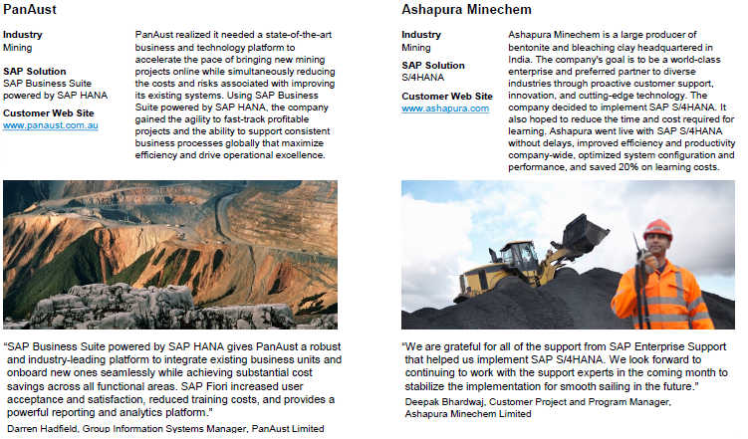
Value derived from SAP
Solutions – Customer’s Perspective

Slide 16
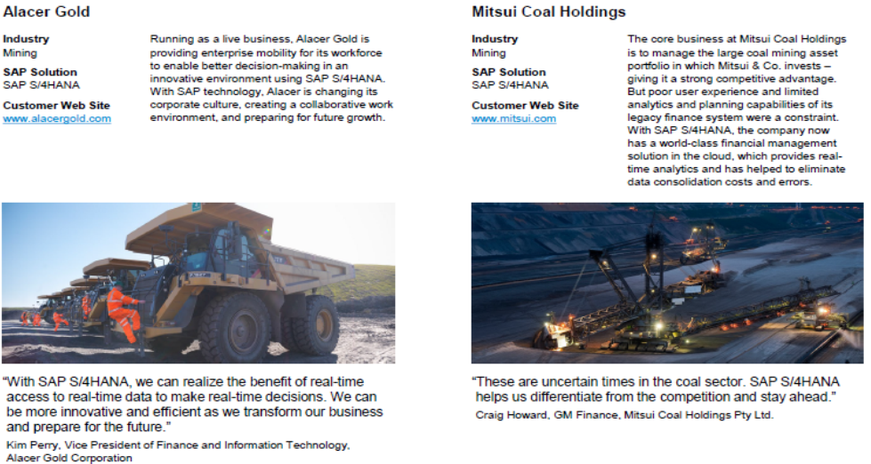
Value derived from SAP
Solutions – Customer’s Perspective

Slide 17
THANK YOU!
WE LOOK FORWARD TO WORKING WITH YOU!
M.Y.Maharshi
Managing Director
MYM Technologies Limited
Flat No:102,Shreya Blossoms, Road no.15/A Jubilee Hills,
Hyd-500033
Email id: maharshi@mymtechnologies.com
Mobile:+91 9849004856
www.lorhanit.com

